Slide 1
PBPK Model Development
PBPK Modeling and MCSim Workshop
QCPT Group
July 9, 2016

Slide 2
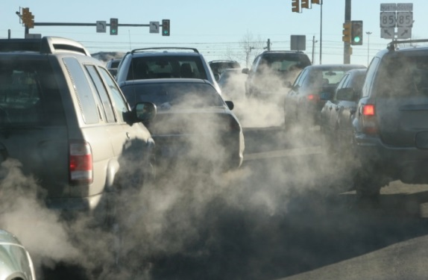
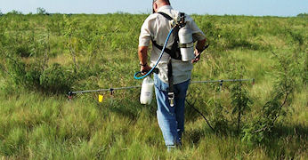
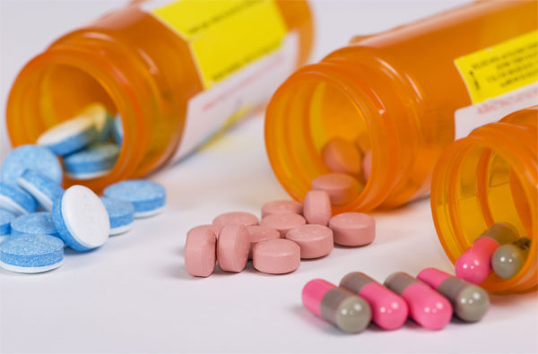
PBPK Motivation
We are constantly exposed to xenobiotics (foreign chemicals) everyday throughout our entire lifetime
Environment
Insecticide residue
Car exhaust
Occupational
Chemical manufacturer
Pesticide applicator
Pharmaceutical
Over the counter drugs
Prescriptions

Slide 3
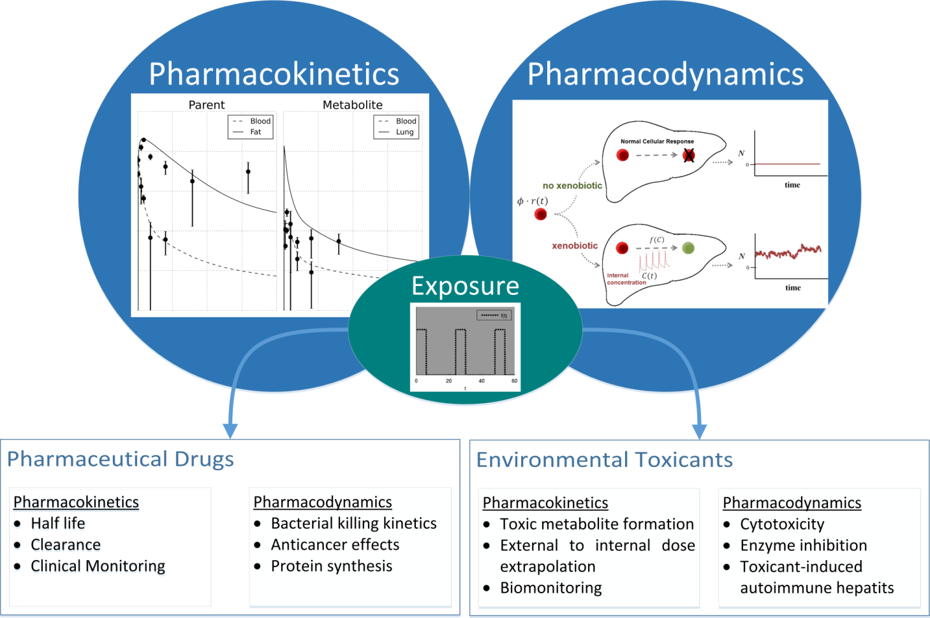
Internal Concentrations
In order to determine biological consequences from these exposures, we must first estimate internal concentrations following a given exposure.

Slide 4
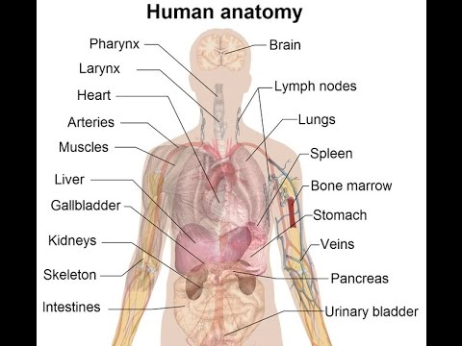
Our goal
Describe a drug within the body through classical chemical engineering governing equations

Slide 5
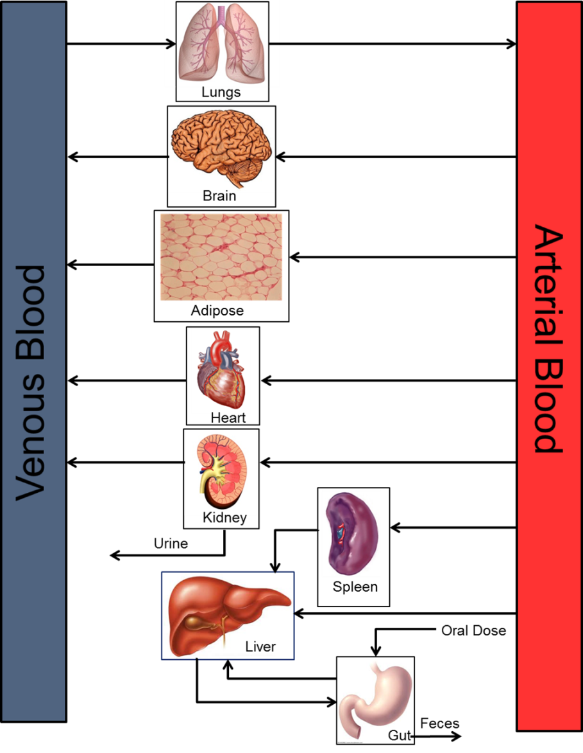
Transform physiology into discrete compartments
Use law of conservation of mass to describe drug from start (dosing) to finish (elimination)
Along the way, predict drug concentrations and bio-transformations throughout the body.

Slide 6
Today’s PBPK Model
Try to keep generic, but give examples using rifapentine
A rifamycin used as part of combination thearpy to treat tuberculosis
Also, hepatotoxicant and overdose can lead to liver injury
Goal of this model is to predict ADME of the drug in tissues of interest (e.g., site of action: lung) and to compare chemical concentrations levels to the minimum inhibitory concentration (MIC) of the tuberculosis bacterium

Slide 7
Compartmentalize
Treat each organ of the body as a different compartment and apply the appropriate equations.

Slide 8
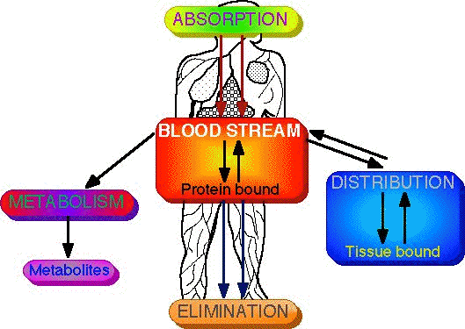
ADME
A: absorption
D: distribution
M: metabolism
E: elimination
Which parts of the body are needed for each process?

Slide 9
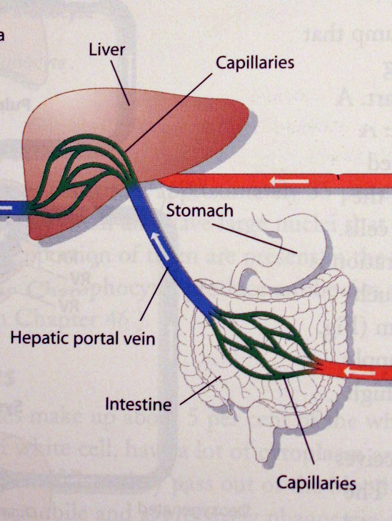
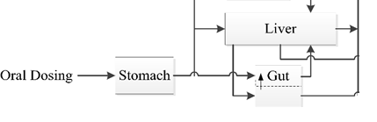
Absorption
Drug dissolution in the stomach
Absorption along the length of the intestine

Slide 10
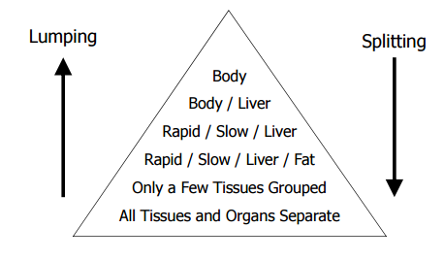
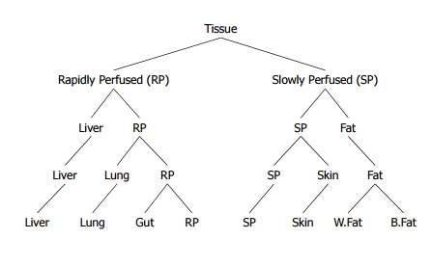
Distribution (I)
Drug actually reaching the tissue
Concerned with tissue of interest
Lumping

Slide 11
Distribution (II)
Drug partitioning into tissue:
“Like dissolves like”
Lypophobic/hydrophilic compound
More drug perfuses (or distributes) to the hydrophilic tissue

Slide 12
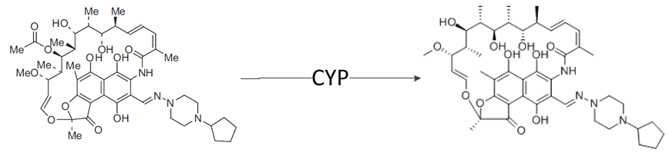
Metabolism
Mostly occurs in the liver
Also: gut, brain, diaphragm, etc.

Slide 13
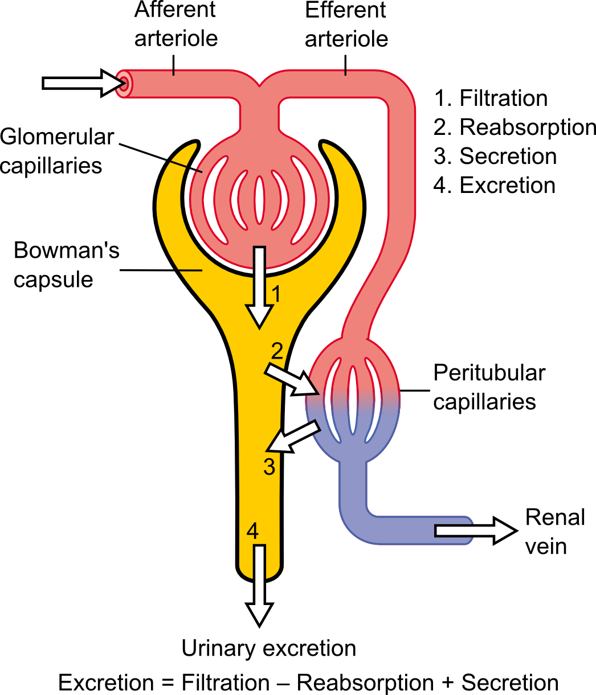
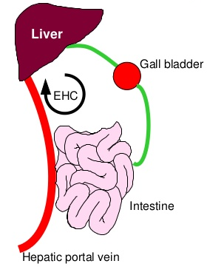
Elimination
Mostly through kidney and bile
Possible through exhalation

Slide 14
Equations
Need to describe each process with coupled ordinary differential equations
Allows us to describe time-course change in drug concentration throughout the body.
Law of Conservation of Mass

Slide 15
Examples (I)
GI Tract (absorption)
First order (Stomach → Gut → Plasma)
Lumped compartment (Stomach/Gut → Plasma)
Dissolution (Solid stomach → Aqueous stomach → Gut → Plasma)

Slide 16
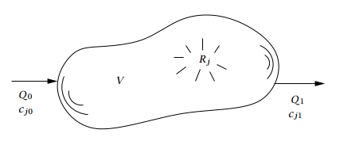
Example (II)
Liver (metabolism)

Slide 17
Example (III)
Tissues (distribution)
Need partition coefficients

Slide 18
Final Rat PBPK model

Slide 19
Final Human PBPK model
Single Dose
Repeated Dose

Slide 20
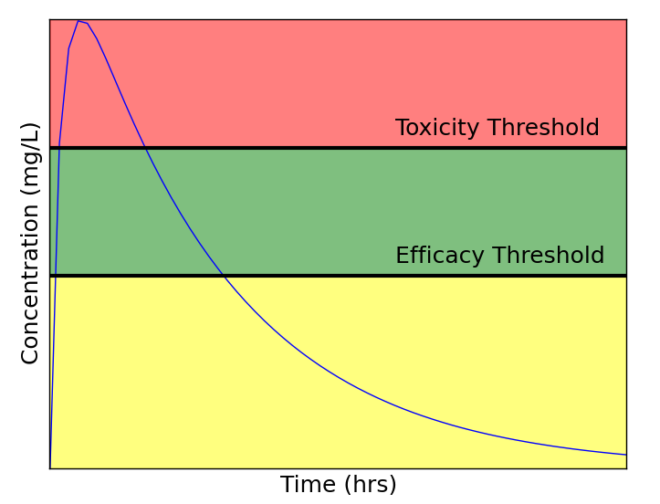
Utilizing the PBPK model
We now have a validated PBPK model at our disposal
Predict biomarker concentrations in the plasma
Determine drug efficacy at site of action
Predict potential organ-specific toxicity

Slide 21
Biomarkers
Link a measurable concentration to the concentration within a tissue
Here, link plasma biomarker to internal concentration
Here, acetaminophen (APAP) concentration within the liver gives an idea of potential hepatotoxicity

Slide 22
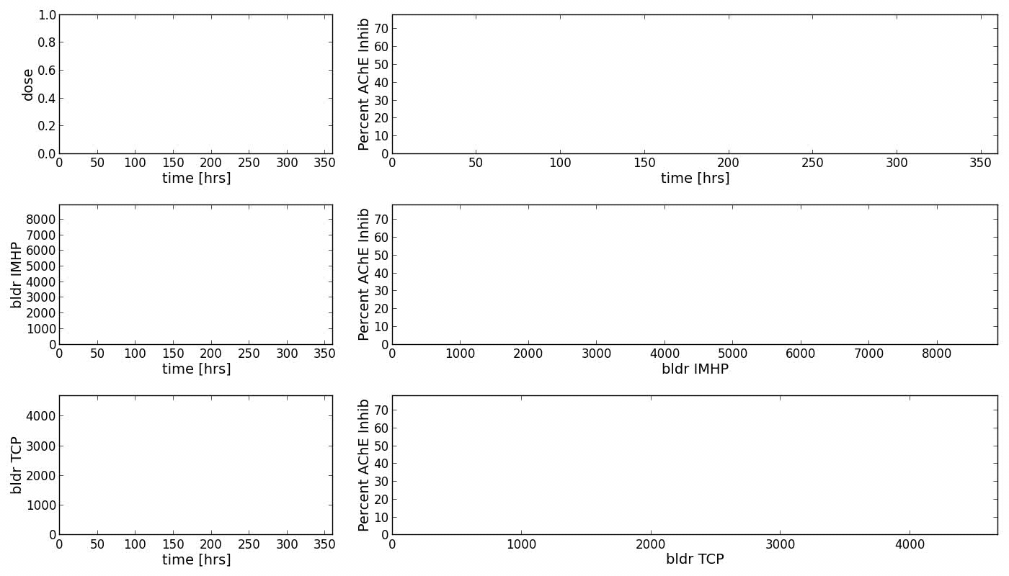

Slide 23
Today …
Introduce the MCSim ODE solver
Set up model files
Set up input files
Parse output files
Integrate Python and MCSim to visualize model output
Plot MCSim output
Compare output to data
Create basic PBPK model
Work towards creating whole-body model for the anti-TB drug: rifapentine

